Slide 1
WHAT IS CREDIT?
This presentation is for information purposes only, this is not legal advice. You should always contact a lawyer for legal questions. Greater Bakersfield Legal Assistance (GBLA) can be reached at (661) 325-5943
Notes:
Hello, my name is Dominica and today we will be discussing credit. This video will explain what credit is... the importance of your credit report... and the importance of your credit score.
This presentation is for information purposes only, this is not legal advice. You should always contact a lawyer for legal questions. Greater Bakersfield Legal Assistance (GBLA) can be reached at (661) 325-5943.

Slide 2
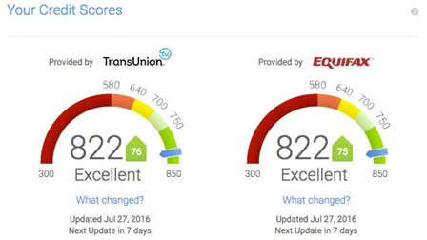
WHAT IS CREDIT AND WHY IS IT IMPORTANT?
Credit is Borrowed money you agree to pay back
There are 3 credit reporting agencies: Equifax, Transunion, and Experian.
Agencies provide consumers with 1 free copy of their credit report annually.
Notes:
First we will discuss what credit is and why it is important?
Credit is borrowed money you agreed to pay back, usually with interest.
Credit is important when renting an apartment, buying a home, refinancing student loans, getting a credit card, and applying for a job. Having good credit is necessary and important to ensure you'll qualify for loans when you need them.
There are 3 credit reporting agencies. Equifax, Transunion, and Experian. You are entitled to a free copy of your credit report annually from all three credit reporting agencies.

Slide 3
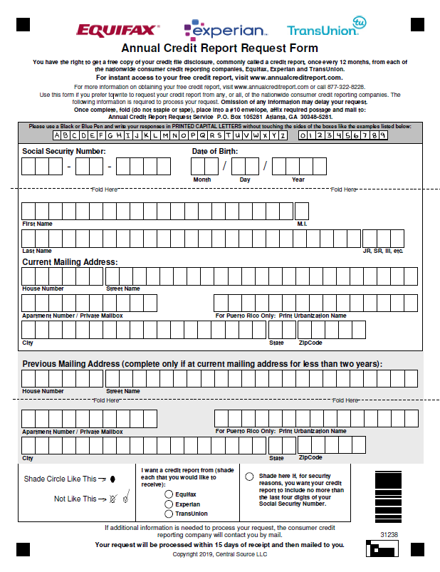
HOW TO REQUEST YOUR CREDIT REPORT
You can also request your annual Credit Report online.
https://www.annualcreditreport.com/index.action
Notes:
You can request your credit report using the Annual Credit Report Request Form attached here or you can request a copy of your credit report online. Follow the link to complete the online request. Please keep in mind, your credit report does not include your credit score.

Slide 4
CREDIT REPORT VERSES CREDIT SCORE
Credit Report
Is a comprehensive list of your lines of credit.
Includes how diligently you paid off outstanding balances (payment history).
Includes negative information such as repossessions or bankruptcies.
Includes public record-wage attachments, judgments, and cosigned loans.
Does not include your credit score.
Credit Score
Is a number generated by using your credit report.
Lenders use your credit score to evaluate how safe or risky you are as a customer.
Lenders use credit score to determine who qualifies for a loan, the amount of interest on a loan, and credit limit.
Your credit score is determined by your payment history, how much credit you use, credit inquires, your credit age, and the types of credit you use.
Notes:
So what is the difference between your credit report and credit score?
A credit report is a summary of how you handle credit accounts. Your credit report includes a comprehensive list of your lines of credit, includes how often you pay outstanding balances, includes negative information such as repossessions or bankruptcies, includes public record wage attachments, judgments, and cosigned loans. Again, your credit report does not include your credit score.
A credit score is a number generated by using your credit report. Lenders use your credit score to evaluate how safe or risky you are as a customer. Lenders also use credit scores to determine who qualifies for a loan, the amount of interest on a loan, and credit limit. Your credit score is determined by your payment history, how much credit you use, credit inquires, your credit age, and the types of credit you use.

Slide 5
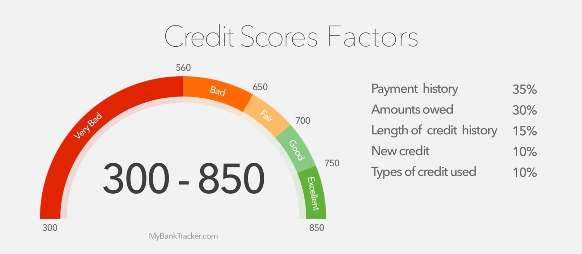
Know What’s on Your Credit Report and your Credit Score
Having negative information on your credit report such as:
Evictions
Public Record (Bankruptcies, Judgement, & Leins)
Collections
Past due utilities
Past due PG&E
Past due Gas
Past due Phone Bill
Past due Water Bill
can hinder you from being approved to rent an apartment. Many landlords and rental agencies may disqualify you if you have negative information on your credit report.
*FSP can assist with one credit check when applying for an apartment.
Notes:
Know what is on your credit report because it will affect your credit score. Having negative information on your credit report such as evictions, bankruptcies, judgements, and liens, collections, or past due utilities, such as PG&E, gas, phone, or water bill can hinder you from being approved to rent an apartment. Many landlords and rental agencies may disqualify you if you have negative information on your credit report.
FSP can assist with one credit check when applying for an apartment. Therefore, it is important to ask a rental agency or potential landlord what range of credit score is needed to be approved. By doing this you can get an idea of your eligibility and likeliness of being approved. For more house searching tips you can review the "House Search" video.

Slide 6
Review your Credit Report and Credit Score
Personal Information
Name
Social Security Number
Date of Birth
Current/previous addresses and Employers
*Use mobile app Credit Karma to check your credit score for free!!!
Notes:
So it is important to take the time and verify your personal information to review the accuracy of your credit report because your credit score is a reflection of your credit report. It is important to verify your name, social security number, your birthday, and both current and previous addresses and employers.
You can monitor your credit score for free through Credit Karma. You should monitor your credit for accuracy, because being aware of your credit report and credit score can help prevent identity theft because Credit Karma allows you to dispute any charges not made by you.

Slide 7
HOW TO DISPUTE AN ERROR ON YOUR CREDIT REPORT
Please visit the website below for more information, instructions, template guides, and informational video.
https://www.consumerfinance.gov/ask-cfpb/how-do-i-dispute-an-error-on-my-credit-report-en-314/#:~:text=If%20you%20identify%20an%20error,documents%20that%20support%20your%20dispute
Notes:
To dispute an error on your credit report please follow the attached link which includes an informational video.

Slide 8
Different Types of Credit
Revolving Credit - Set limit, minimum monthly payment
Charge Credit – No Pre-Set spending limit, full balance due monthly
Service Credit - cellular service, utility providers
Installment Credit - Loan paid over specific period
Notes:
There are different types of credit.
There is Revolving Credit, which is credit given with a limit you can spend up to, and you are expected to pay towards the balance each month.
Charge Credit is credit given with no pre-set spending limit, but you need to pay the total balance in full each month.
So lets look at an example when using revolving credit verses charge credit. If you spend $2,000 at Target with a revolving credit card, then you can make monthly payments until your total charge is paid in full. If you spend $2,000 at Target with a charge credit card, then you are expected to pay the total $2,000 balance by your next billing cycle. So it is important to be aware of the type of credit cards you use.
Service Credit is credit for services such as a cell phone bill, an electricity bill, and a gym bill, but all of these do not all report to credit agencies
And finally we have Installment Credit, which are payments set for a period of time for a specific amount of money, for example a car loan or a mortgage loan.

Slide 9
TIPS TO IMPROVE YOUR CREDIT
Always pay bills on time.
Keep low balances on credit cards.
Pay credit card bills in full each month
Monitor your credit report to ensure accuracy.
Avoid too many credit inquires in a short period.
Protect your finances by keeping records.
Always watch for fraud or scams.
Notes:
Tips to improve your credit.
Always pay bills on time, maintain low balances on credit cards, pay credit card bills in full each month, monitor your credit report to ensure accuracy, avoid too many credit inquires, protect your finances by keeping your records in order, and always watch for fraud or scams.

Slide 10
https://www.consumer.ftc.gov/topics/credit-and-loans
For more information on
credit, you can visit the website above.
Notes:
To summarize this presentation, we reviewed why credit is important, the difference between your credit report and credit score, and the different types of credit available. For more information on credit you can visit the Federal Trade Commission link listed above.

