Slide 1


Conserving Energy at Home
Ways to decrease energy usage to maximize your bottom line (your money) and programs to assist with your various energy needs.
This presentation is for information purposes only, this is not legal advice. You should always contact a lawyer for legal questions. Greater Bakersfield Legal Assistance (GBLA) can be reached at (661) 325-5943.
Notes:
Script: Hello! My name is Tasha Perry and welcome to the next installment in the Family Stabilization Virtual Workshop series! In this module, you will learn useful information about conserving energy at home. This module will explain why saving energy is important, ways to cut down on utility expenses... and resources in the community that can support you in these efforts as you work towards self-sufficiency. Keep in mind that this presentation is for information purposes only, this is not legal advice. You should always contact a lawyer for legal questions. Greater Bakersfield Legal Assistance (GBLA) can be reached at (661) 325-5943....with that being said...let's begin!

Slide 2
Why is Conserving
Energy Important to Me?
More income for you and your family by reducing money spent on utility bills.
      Emergency Fund
      Unexpected expenses
      Allows you more flexibility to do the things you love with your family.
Notes:
Slide 2: So you might be thinking….why is conserving energy important to me? Well…good question! Cutting down on your energy usage will provide you and your family more income that can be utilized in other areas of your life.
As we all know…life can hit us with unexpected and unwelcome surprises such as car repairs, medical bills and other extra expenses. Money saved on utility expenses can afford you the ability to save an emergency fund so that you can pay for these unexpected expenses. Additionally, money saved by conserving energy can be used towards the things you love for the people you love. This could be activities such as birthdays, holidays, trips or extra-curricular sports for your children.

Slide 3
Why is Conserving
Energy Important to Me (Part 2)?
It's better for your health.
      A well-insulated house can reduce indoor pollutants, which can help people with breathing issues such as asthma.
      Houses that are well-insulated and properly ventilated also reduce moisture, prevents mold, and can lower and risk of breathing related illnesses.
Notes:
Slide 3:
Did you know that conserving energy is also good for your health? A well-insulated house can reduce indoor pollutants in the air. This in turn can with reduce breathing issues for people who have asthma and other sensitives to air pollutants. Additionally, homes that are properly ventilated reduce moisture which in turn prevents mold; a fungus that can cause mild to serious health conditions.

Slide 4
Why is Conserving
Energy Important to Me (Part 3)?
It's good for the environment.
      Reducing energy usage reduces your carbon footprint (how much you contribute to polluting the earth).
Source: https://www.energysage.com/energy-efficiency/why-conserve-energy/
Notes:
Slide 4:
Did you know that conserving energy is also good for the environment? When we use energy we put out carbon dioxide into our environment, which is known as our carbon footprint. This carbon dioxide is not good for our ozone layer and causes negative climate changes. So by reducing energy, you reduce your carbon footprint and limit these changes occurring in our atmosphere.
Now that we have learned why conserving energy is important…let’s discuss ways for you save on utility expenses.

Slide 5

What Can I Do to Conserve Energy?
Be mindful of energy usage.
  Small steps will maximize your savings on energy usage.
Check to make sure your place is insulated well.
  A properly insulated home is heated and cooled more efficiently and less expensively.
  Heat naturally travels from warmer to cooler places.
    Lack of insulation will result in heat within the home trying to escape to the outside during the cold winter months. In the warmer months, the opposite effect with occur and heat will enter your home when you and your family are trying to stay cool.
Source: https://home.howstuffworks.com/green-living/how-to-conserve-energy-at-home2.htm
Notes:
Side Note: Estimated that 5% of energy usage is from "standby power".
Slide 5:
Script: So what can you do to conserve energy? Just by simply asking yourself that question, you’re already one step closer decreasing your energy usage. By being mindful of your energy usage will help you to start making small changes because it’s those small changes that are going to maximize your savings on utilities.
The first step is to make sure your home is well insulated. Do you notice gaps under or around entry doors or windows? Lack of insulation in your attic? Need a blanket for your water heater? If you answered yes to any of these questions, you could use an upgrade to the insulation in your house to further increase your energy conservation. A properly insulated home is heated and cooled more efficiently and less expensively. Heat naturally travels from warmer to cooler places. Lack of insulation will result in heat within the home trying to escape to the outside during the cold winter months. In the warmer months, the opposite effect with occur and heat will enter your home when you and your family are trying to stay cool. More information will be provided in the next section regarding resources to help with your insulation needs.

Slide 6
What Can I Do to Conserve Energy (Part 2)?
General Tips: Turn off lights when not in rooms, handwash dishes, cold water detergent for laundry (full loads and liquid only), unplug appliances when not in use, limit trips to the refrigerator, and keep thermostat off when no one is home.
Source: https://home.howstuffworks.com/green-living/how-to-conserve-energy-at-home2.htm
Notes:
Side Note: Estimated that 5% of energy usage is from "standby power".
Slide 6:
Here are some general tips that apply year round when trying to conserve energy: Turn off lights when not in rooms, handwash dishes, cold water detergent for laundry (full loads and liquid only), unplug appliances when not in use, and limit trips to the refrigerator and keep thermostat off when no one is home.

Slide 7
What Can I Do to Conserve Energy (Part 3) ?
Tips for the Cooler Months: Use natural light during the day to trap in heat, home-cooked meals in evenings can help raise the temperature in the evenings and down/synthetic-filled comforters for sleeping. A general rule is to set your thermostat at 69 degrees during the winter months.
Tips for the Warmer Months: Keep shades, blinds and curtains shut to keep out heat, bulk cook to minimize increased heat and run ceiling or oscillating fans. A general rule is to set your thermostat to no lower than 78 degrees during the warmer months.
Source: https://home.howstuffworks.com/green-living/how-to-conserve-energy-at-home2.htm
Notes:
Side Note: Estimated that 5% of energy usage is from "standby power".
Slide 6:
For the cooler months: Use natural light during the day to trap in heat, home-cooked meals in evenings can help raise the temperature in the evenings and down/synthetic-filled comforters for sleeping. A general rule is to set your thermostat at 69 degrees during the winter months.
For the warmer months, Keep shades, blinds and curtains shut to keep out heat, bulk cook to minimize increased heat and run ceiling or oscillating fans. A general rule is to set your thermostat to no lower than 78 during the warmer months.

Slide 8
Conserving Energy Resources:
Community Action Partnership-Insulation/Weatherization
Through Community Action Partnership of Kern, weatherization is a resource offered in the community to assist families in becoming more energy efficient. If a family qualifies, they may be eligible to the following:
Attic Insulation.
Refrigerator replacement; requires an evaluation to see if it qualifies for replacement.
Weatherstripping around doors, installing door shoes and thresholds.
Caulking all doors and windows.
Low-flow shower heads and aerators.
Water heater blankets.
Carbon monoxide detectors.
Safety check of all gas appliances.
Set-back thermostat.
Limited minor home repairs.
Duct testing of FAU heating and cooling systems.
Smoke alarms.
Note: If you are a renter, your property owner or their representative must sign an energy service agreement giving CAPK permission to weatherize the property.
For more information regarding this program, call 661-336-5203, or 1-800-988-7771. Walk-ins are welcome at 300 19th Street, Bakersfield, CA 93301.
Notes:
As we discussed in the last section, the first step to conserving energy is a well-insulated home. You look around and notice the insulation in your home is an issue and could use an upgrade…so how do I fix it you might be thinking? Well…great question! The answer to that is Community Action Partnership of Kern, who have a program designed specifically for your insulation needs. Through Community Action Partnership of Kern, weatherization is a resource offered in the community to assist families in becoming more energy efficient. If a family qualifies, they may be eligible to the following: Attic Insulation, Refrigerator replacement; requires an evaluation to see if it qualifies for replacement, Weather-stripping around doors, installing door shoes and thresholds, Caulking all doors and windows, low-flow shower heads and aerators, water heater blankets, carbon monoxide detectors, safety check of all gas appliances, set-back thermostat, limited minor home repairs, duct testing of FAU heating and cooling systems and smoke alarms. Keep in mind if you are a renter, your property owner or their representative must sign an energy service agreement giving CAPK permission to weatherize the property. For more information regarding this program, call 661-336-5203, or 1-800-988-7771. Walk-ins are welcome at 300 19th Street.
Now that we have covered insulation, let's move-on to resources that can assist with utility expenses...

Slide 9
Having Problems Paying Your Utility Bill?
Conserving Energy Resource:
Low-Income Home Energy Assistance Program (HEAP)
This program provides utility assistance that include gas, propane and electric.
This benefit is allowed once in a 12-month period.
An applicant must be Kern County resident and have total household income at or below 150% of the federal poverty income guidelines.
Have a utility bill with at least 22 days of service.
For more information, please call 2-1-1 or call 661-336-5203 to schedule an appt.
Notes:
So you’re doing your best to conserve energy and keep those utility bills low and within budget, but still find yourself struggling to pay the utility bills. Then HEAP may be just the program for you! The Home Energy Assistance Program is a resource that provides utility assistance that include gas, propane and electric.
This benefit is allowed once in a 12-month period.
An applicant must be Kern County resident and have total household income at or below 150% of the federal poverty income guidelines.
Have a utility bill with at least 22 days of service.
For more information, please call 2-1-1 or call 661-336-5203 to schedule an appt.

Slide 10
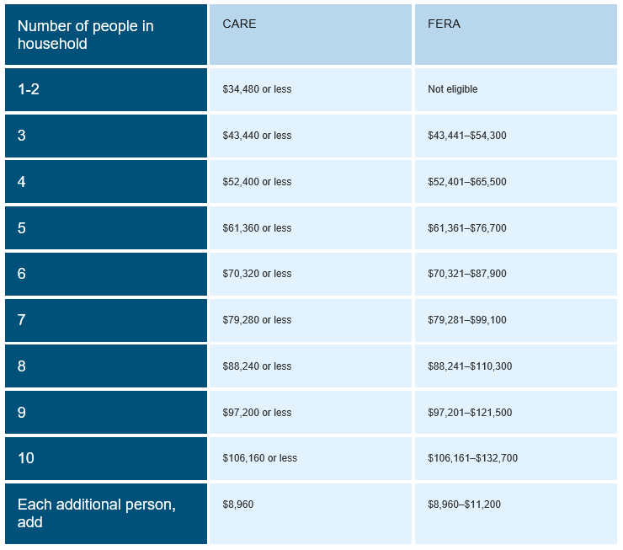
Ways to Save
Conserving Energy Resource: CARE and FERA
PG&E Resources:
  CARE (California Alternate Rates for Energy Program) is a monthly discount of 20% or more on gas and electric based on income guidelines for income/number of people in household.
  FERA (Family Electric Rate Assistance Program) is a monthly discount of 18% on electricity only. Households of 3 or more may qualify for this program.
Apply online at www.pge.com or for questions call 1-866-743-2273.
https://www.pge.com/en_US/residential/save-energy-money/help-paying-your-bill/longer-term-assistance/care/care.page?
Notes:
Slide 6: Your money matters so making the most out of every dollar so that it can be best used towards your family is important. With that being said, PGE has two programs for low-income families that allows you to receive discounts on your PGE bill. CARE (California Alternate Rates for Energy Program) is a monthly discount of 20% or more on gas and electric based on income guidelines for income/number of people in household.
FERA (Family Electric Rate Assistance Program) is a monthly discount of 18% on electricity only. Households of 3 or more may qualify for this program.
See the attached chart to see if you may qualify.
Apply online at www.pge.com or for questions call 1-866-743-2273.

Slide 11
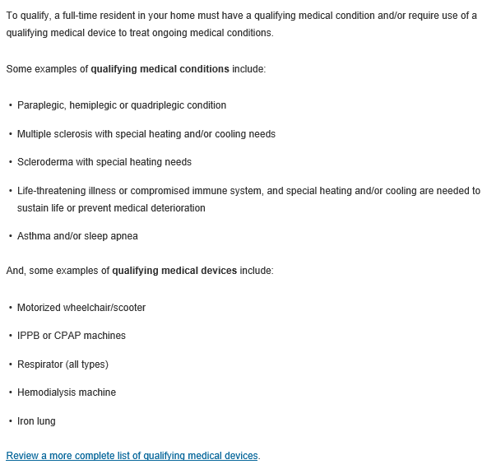
Ways to Save
Conserving Energy Resource: PG&E's Medical Baseline Program
  This program is an assistance program for customers who depend on power for certain medical and independent living needs. This includes two ways to support customers by:
    A lower rate on monthly energy bills.
    Extra notifications in advance in the event of a Public Safety Power Shut Off.
Apply online at pge.com or call
  1-800-743-5000 for more information.
Are you eligible?
Notes:
In addition to the PGE discount programs mentioned in the previously section, PGE also has a Medical Baseline Program. This is an assistance program for customers who depend on power for certain medical and independent living needs. This includes two ways to support customers by having:
A lower rate on monthly energy bills.
Extra notifications in advance in the event of a Public Safety Power Shut Off.
To qualify, a full-time resident in your home must have a qualifying condition and/or require use of a qualifying medical device to treat ongoing medical conditions. Refer to the list in this section of qualifying medical conditions or devices to see if you qualify. For a more detailed list or to apply for this program, please visit pge.com or call 1-800-743-5000 for more information.

Slide 12
Ways to Save
Conserving Energy Resource: SoCalGas Assistance Programs
If your gas is separate and through SoCalGas, they offer the same assistance programs similar to PG&E that assist/reduce natural gas expenses that include:
SoCalGas CAREs
Medical Baseline Allowance
*If your electricity and gas are separate, you must apply for both CARE and the Medical Baseline Allowance through PG&E AND SoCalGas to receive credits through both providers.
*To apply for SoCalGas Assistance Programs, go to www.socalgas.com.
Notes:
Similarly to PGE, if your gas is separate and through SoCalGas, they offer the same assistance programs to reduce natural gas expenses that include:
SoCalGas CAREs
Medical Baseline Allowance
If your electricity and gas are separate, you must apply for both CARE and the Medical Baseline Allowance through PG&E AND SoCalGas to receive credits through both providers.
*To apply for SoCalGas Assistance Programs, go to www.socalgas.com.

Slide 13
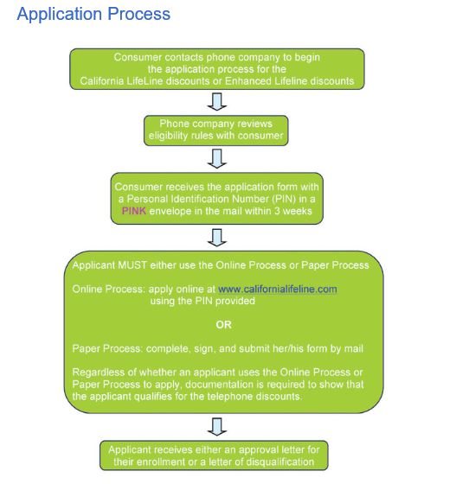
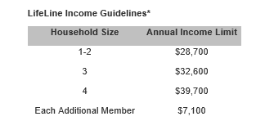
Ways to Save
Conserving
Energy Resource:
California LifeLine Program
California LifeLine is a state program that provides discounted home and cellphone services to eligible households.
  They have a program-based qualification method (CalWORKs, CalFresh, SSI, Medical etc.) or income-based qualifications (see below).
https://www.cpuc.ca.gov/General.aspx?id=2752#How_to_Apply_or_Renew
Notes:
In addition to being potentially eligible to receive discounts of on your gas and electric utilities, there are also programs available for your home and cellular phones.
California LifeLine is a state program that provides discounted home and cellphone services to eligible households.
They have a program-based qualification method (CalWORKs, CalFresh, SSI, Medical etc.) or income-based qualifications (see the chart below).
The application process if very specific that you must first contact your phone company directly and request the California LifeLine discount. The chart to the right outlines the application process and can also be accessed at the website listed below the flowchart.

Slide 14

Conclusion
Conserving Energy Matters
You have control in how much energy you use.
There are resources available to help reduce energy costs and/or assist when situations arise when you cannot afford utility bills.
Thank You!
Notes:
Script: This concludes the FSP Workshop Series about conserving energy. Thank you so much for doing your part by showing up and learning more about ways to save on utilities. In this series, we covered that conserving energy matters and that you have in control in how much energy you use. We also learned that there are resources available to help reduce energy costs and/or assist when situations arise when you cannot meet expenses on your own. If you have any additional questions about the information covered in this series, please reach out for your FSP SSW who will be happy to assist you….and remember…energy saved is energy you can put into other important areas in your life. Thank you.

