Slide 1
Budgeting & Money Management
What is the first step in taking control of your money and improving your financial situation?
This presentation is for information purposes only, this is not legal advice. You should always contact a lawyer for legal questions. Greater Bakersfield Legal Assistance (GBLA) can be reached at (661) 325-5943.
Notes:
Hello my name is Dominica and today we will be discussing Budgeting and Money Management.
What is the first step in taking control of your money and improving your financial situation? Pause this video and take some time to think about this question... (30 secs?)
Now that you had time to think, a good place to start is to evaluate your financial situation. It is important to manage your money, by knowing how much money you have coming in and how much money you have going out. This is key to putting your family in a better financial situation.
This presentation is for information purposes only, this is not legal advice. You should always contact a lawyer for legal questions. Greater Bakersfield Legal Assistance (GBLA) can be reached at (661) 325-5943.

Slide 2
Think about how you spend your money each month... Is your current budget working for you?
When creating a budget add all incoming income such as:
Cash Aid/Calfresh
Employment (Net Earnings)/Self-Employment
EDD/ Unemployment Benefits
Child Support
SSI/SSP
Survivors Benefits
Notes:
Think about how you spend your money each month... Is your current budget working for you? When creating a budget you should add all incoming income such as cash aid, Calfresh, employment, self-employment, EDD/unemployment benefits, child support, SSI/SSP, survivors benefits, and any other incoming income. Once you have your total monthly income then you will need to write out all monthly expenses.

Slide 3
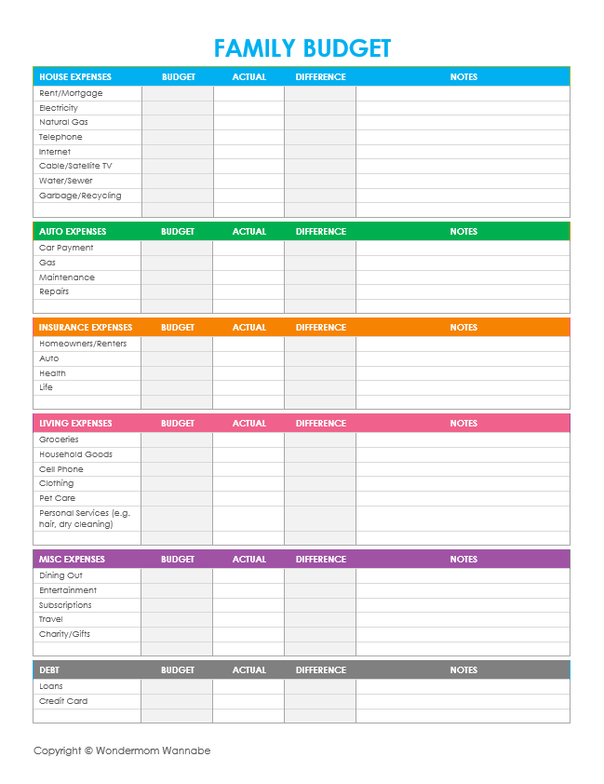
Example of Family Budget
Notes:
Attached is a family budget sheet you can use to list all your expenses. When completing this family budget be realistic about the amount of money you spend on each category. If you find yourself with a negative balance, lets talk about how you can improve your budget.

Slide 4
When Creating a Budget Know the Difference Between ​
NEED VS. WANT
Rent/ Mortgage
Utilities​
Groceries
Credit Cards​
Car payment/Insurance​
Dining Out​
Clothing/Shoes​
Personal Care​
Gifts/Presents​
Vacation​
Cell Phone Bill​
Wi-Fi
Call 211 for food baskets or visit the website below for free meal services at the Mission
https://www.themissionkc.org/meals.html
Notes:
When creating a budget it is important for you to know the difference between a WANT and a NEED.
A Need is an expense that covers your basic needs. Before you pay other bills or expenses, you should ALWAYS pay your rent first, and then electricity/ gas and then groceries. This way you will guarantee you can provide shelter, electricity/gas, and food for you and your family. If after paying your rent and utility bills you do not have enough funds for groceries, you can contact 211 for food baskets or go to the Mission for 3 free meals a day.
A Want is an expense that is not a basic need and is optional spending. You should never prioritize a WANT over a NEED. A Want can be dining out, buying new clothing or shoes, spending money on personal care such as getting your hair or nails done, buying gifts or presents, taking vacations, paying for WIFI and even your cell phone bill. Although it is important to have a cellphone for communication, there are free government cellphones available so you do not need to pay for cellphone services if it is outside of your budget.

Slide 5
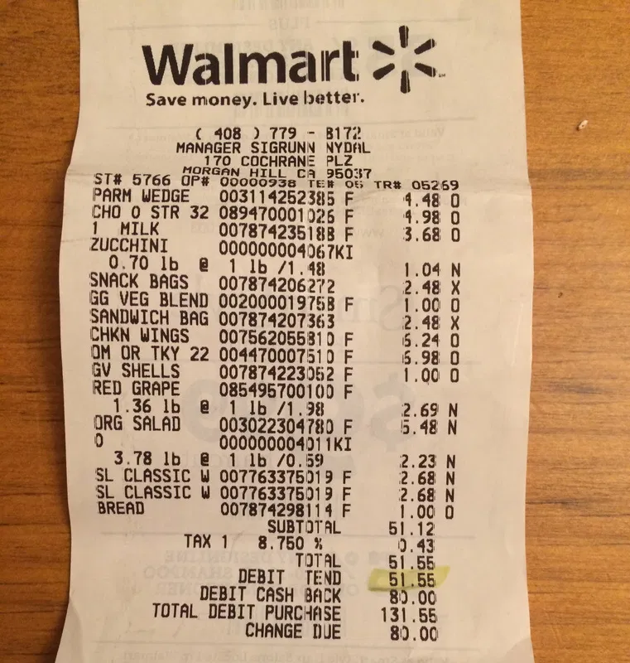
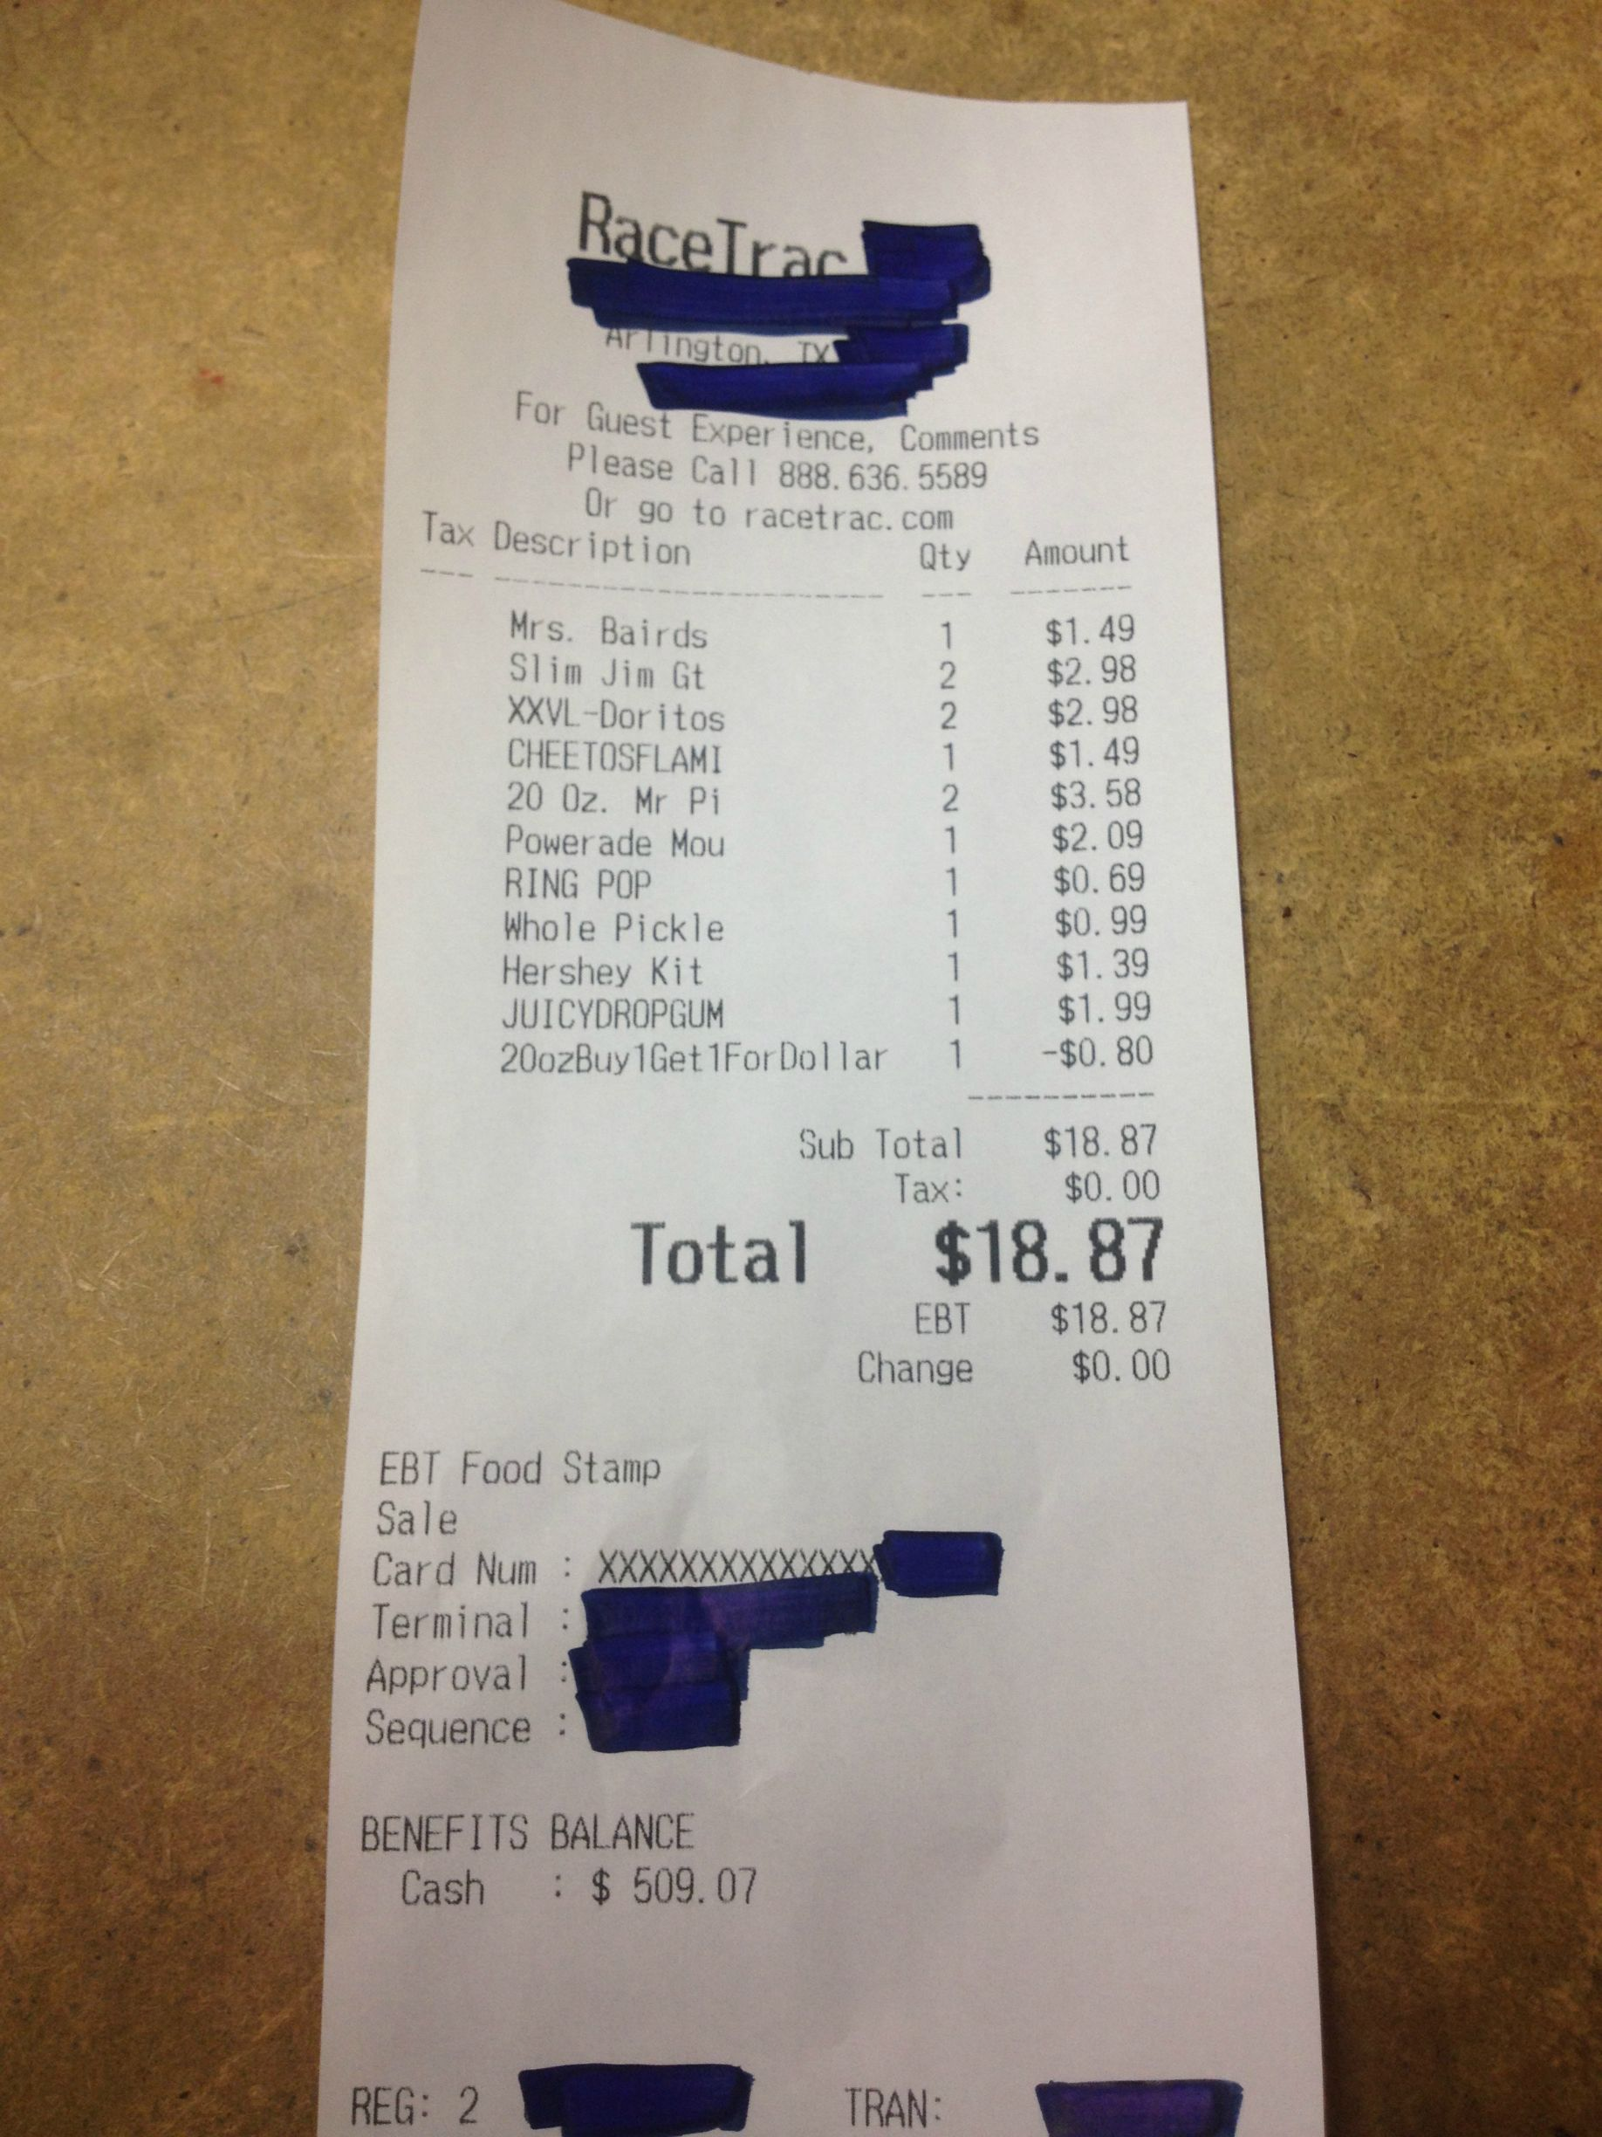
This receipt shows items that are a NEED
This receipt shows items that are a WANT
Notes:
The receipt on the left shows items that are a need to make a full balanced meal. The receipt on the right shows items that are a want. Cheetos, Doritos, and a Ring Pop are not a need. When spending your Cal FRESH, be mindful of how much you are spending, because $18+ dollars a day can add up quickly. Please note when grocery shopping always try to find the cheapest sale, and only buy want you need. Another tip is to plan out your meals in advanced to create a grocery list to avoid overspending.

Slide 6
How can employment improve your budgeting and money management?
Employment can help support you and your family to reach your dreams and goals
Notes:
Slide 6: Hello! My name is Tasha and I’ll be covering this next section of this virtual presentation. Now that you have learned about budgeting and money management…let’s learn about how employment can be a tool to help further support you and your family to reach your dreams and goals.

Slide 7
Why Employment?
*Everyday Benefits
More income ensures the bills are paid and your family's needs are met.
More flexibility in your budget to save and do things that you would like to do for yourself and family (WANTS: movie night, trip to the beach, trip to the zoo, a special birthday party etc.)
*Personal Benefits
Decrease in stress because you know your family is being supported.
Increased independence and boost in self-confidence.
Increase in socializing (friendship) with other adults while giving back to the community.
*Family Benefits
Employment can be a tool to increase stability for you and your family while working towards your goals.
Notes:
Slide 7: Why employment? Let’s talk about it! Employment offers a variety of benefits that not only support your everyday living but offer personal benefits that in turn positively affect your family.
Let’s start with the everyday benefits. More incomes ensures the bills are paid and your family’s needs are met. Employment also gives you more flexibility in your budget to save and do things that you would like to do for yourself and family WANTS like movie night, trip to the beach, trip to the zoo, a special birthday party etc can become realities because you have the income to support these experiences.
Employment offers a variety of personal benefits as well. Your stress levels can decrease because you know your family is being supported. Less stress if good for your health! Employment also increases your independence and can boost your self-confidence while providing for your family. Employment also allows you the opportunity to expand your social circles and allow you to connect and meet other people that can lead to lasting friendships. Through employment, you’ll also be giving back the community, which is something to take pride in!
Most importantly, your family benefits through employment. You are ensuring stability for you and your children while securing a better future!

Slide 8
Did you know that Welfare-to-Work can help?
Our purpose is to help you become self-sufficient. Your goal of bettering your family is our goal too!
Welfare-to-Work has activities designed to support you and your employment goals whether you are job searching or looking to add work experience to your resume.
Notes:
Slide 8: Did you know that WTW can help? Our purpose is to help you to become fully self-sufficient. Your goal of bettering your family is our goal too!
WTW has activities designed to support you and your employment goals whether you are job searching or looking to add work experience to your resume. So let’s talk about it!

Slide 9
Employment Activities Through Welfare-to-Work: Job Search Activities
Ezone
Benefits of this activity is that it introduces you the job market and how to navigate entering the workforce.
Focuses on career development, positive attitudes, interpersonal skills, developing work ethic all while job searching and getting connected to leads in the community.
Employers Training Resource (ETR)
Benefits of this activity include working one-on-one with a Job Developer who can give support, tips and advice related job searching. They can also connect you to interviews and jobs leads in the community.
Great activity if you have prior work experience and are work ready.
Notes:
Slide 9:
First, let’s discuss some of the job searching activities that WTW has to offer: There are two primary job-searching activities that WTW offers based on your level of work experience and what you are waiting to gain out of the activity. The first job searching activity is called Ezone. Ezone is a good introductory job searching activity especially good for those new to the workforce or have been out of the market for a while. Benefits of this activity is that it introduces you the job market and how to navigate entering the workforce. It also focuses on career development, positive attitudes, interpersonal skills, developing work ethic all while job searching and getting connected to leads in the community.
Our second job searching activity is called Employer’s Training Resource or (ETR).
Some benefits of this activity include working one-on-one with a Job Developer who can give support, tips and advice related job searching. They can also connect you to interviews and jobs leads in the community. This is a great activity if you have prior work experience and are work ready.
Now that we have discussed job searching activities...let’s learn about our work-experience activities.

Slide 10
Employment Activities Through Welfare-to-Work: Work Experience Programs
Employment Preparation Program (EPP)
Benefits of this program is it adds applicable work experience to your resume.
Add on to prior skills, knowledge and training.
Variety of different work sites all over Kern County (retail, clerical, labor, food service, customer service etc.)
Activity is initially unpaid with the opportunity to transition to being paid.
Paid Work Experience
(PWEX)
Activity that starts as EPP and then transitions to PWEX.
Eligible after 4 weeks in the EPP Program.
Ways to become eligible include being on time every day and satisfactory progress reports.
6-month activity that can lead to permanent employment.
Notes:
Slide 10:
WTW offers a work experience program called Employment Preparation Program or what we call “EPP”. The benefits of this program is that it adds applicable work experience to your resume.
This in turn allows you to add on to prior skills, knowledge and training that you’ve received in the past.
There are a variety of different work sites all over Kern County that include but are not limited too: retail, clerical, labor, food service and customer service.
A great transitional activity from EPP is our Paid Work Experience Program or what we called “PWEX”. This program is eligible to participants after working a minimum of 4 weeks in the EPP program. Ways to become eligible include being on time every day and satisfactory progress reports.
This is a 6-month activity that can lead to permanent employment.

Slide 11
Other Welfare-to-Work activities that can help with money management:
Notes:
For more information on budgeting and money management, please contact your WTW SSW to be referred to the NOW Workshops Self-Sufficiency Modules, which includes information on Money Management. Any of the workshops listed above are available for you to enroll.

Slide 12
Interested in Welfare-to-Work Activities?
Contact your Welfare-to-Work Social Worker today and take that next step towards self-sufficiency, independence and financial freedom!
Notes:
Slide 12: If any of the previously mentioned activities are of interest to you, please contact your WTW SSW and take that next step towards self-sufficiency, independence and financial freedom. We can’t wait to hear from you!

Slide 13
Just a Few Reminders...
Budgeting & Money Management is the first step in improving your financial situation
Know where you are spending your money by creating a budgeting spread sheet
When creating your spread sheet, know the difference between a NEED and a WANT
Employment can increase your budget so you can enjoy everyday, personal and family benefits
Welfare-to-Work activities Ezone, ETR, EPP & PWEX can assist you on your journey to attain employment
When you do find employment, Welfare-to-Work can assist with a variety of supportive services (childcare, transportation, clothing) to further support you
Thank you for taking time out of your day to learn about budgeting, money management.
Reach out to your Welfare-to-Work SSW if you have any needs, questions or help starting the job searching/employment process. We are here for you.
Notes:
Slide 13:
Just a few reminders and a brief summary of what we have covered today.
Budgeting & Money Management is the first step in improving your financial situation
Know where you are spending your money by creating a budgeting spread sheet
When creating your spread sheet, know the difference between a NEED and a WANT
Employment can increase your budget so you can enjoy everyday, personal and family benefits
Welfare-to-Work activities Ezone, ETR, EPP & PWEX can assist you on your journey to attain employment
When you do find employment, Welfare-to-Work can assist with a variety of supportive services (childcare, transportation, clothing) to further support you
Thank you for taking time out of your day to learn about budgeting, money management. Reach out to your Welfare-to-Work SSW if you have any needs, questions or would like help starting the job searching/employment process. We are here for you.

