Slide 1


Avoiding Evictions
The content given is for informational purposes and is not legal advice. You should always contact a lawyer for legal questions.
Greater Bakersfield Legal Assistance can be reached at 661.325.5943
Notes:
Hi my name is Amanda and today we will discuss information on avoiding evictions
We will be discussing
How to avoid evictions
Videos you can watch to help you if you receive an eviction notice
Covid 19 and eviction
And websites you can visit for information on your housing needs
This is for information purposes only, this is not legal advice.

Slide 2
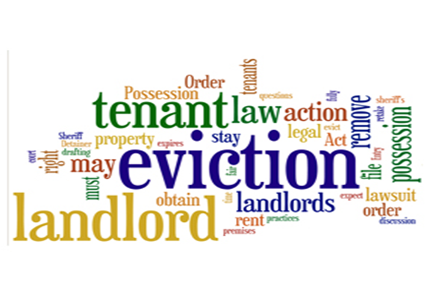
You can avoid evictions by
1.Reviewing your lease agreement. You can be evicted for violating a term on your lease.
2.Paying your rent on time...if you can't pay your full rental amount on time speak to your landlord
3.Set a budget if necessary (see video on Budgeting and Money Management)
4.Respond to the Notice to Quit/ Pay or Quit Notice immediately
5.Make back rent payments
Example: If your lease agreement does not allow for pets and you try to sneak a pet into the unit, you can be served an eviction notice.
Contact Greater Bakersfield Legal Assistance 661-325-5943 or
Landlord Tenant Assistance Center 661-321-3997 if you are served an eviction notice
The content given is for informational purposes and is not legal advice. You should always contact a lawyer for legal questions. Greater Bakersfield Legal Assistance (GBLA) can be reached at (661) 325-5943
Notes:
You can avoid evictions by
1. Reviewing your lease agreement: Review your lease agreement in detail to make sure you are in compliance with the rules/terms and do not breach your lease. Examples of terms that that are often found in lease agreement are: how many days in a row a guest can stay, how many days in a 12 month period a guest can stay, can you have a pet, can you dry your clothing on your balcony railing, can you use a grill on your property, is smoking prohibited on property, can you have a waterbed. By knowing the terms of your lease agreement, you can better avoid being evicted for violating the terms on your lease.
2. Paying your rent on time...if you can't pay your full rental amount on time speak to your landlord
3. Set a budget if necessary - See video on Budgeting and Money Management.
4. Respond to the Notice to Quit/ Pay or Quite notice immediately
5. Make back rent payments if necessary.. Again speak to your landlord to make arrangements
The content given is for informational purposes and is not legal advice. You should always contact a lawyer for legal questions regarding eviction.

Slide 3
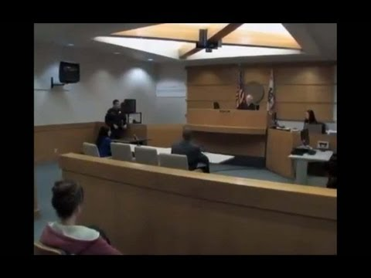

If you are served an eviction notice, these videos can guide you through the process...
Please click the website link below for videos on the eviction process
https://kclawlib.org/unlawful-detainer/
The content given is for informational purposes and is not legal advice. You should always contact a lawyer for legal questions. Greater Bakersfield Legal Assistance (GBLA) can be reached at (661) 325-5943
Notes:
If you were served an eviction notice, you can visit the kern county law library website below to view videos that can help guide you through the eviction process.
It is highly recommended that you also contact GBLA or the Landlord Tenant Center if you have questions regarding your eviction notice.
The content given is for informational purposes and is not legal advice. You should always contact a lawyer for legal questions. Greater Bakersfield Legal Assistance (GBLA) can be reached at (661) 325-5973

Slide 4


COVID- 19 and Evictions
If you have been financially affected by COVID-19 by losing employment, having your hours reduced, or having to stay home to care for family members, then you have certain protection available to you.
For the most up to date information on new laws, contact Greater Bakersfield Legal Assistance
(661) 325-5943
or
the Landlord Tenant Assistance Center
(661) 321- 3997
The content given is for informational purposes and is not legal advice. You should always contact a lawyer for legal questions.
Greater Bakersfield Legal Assistance (GBLA) can be reached at (661) 325-5943​
Notes:
Due to the COVID-19 pandemic, new laws have been enacted to help protect renters from eviction if they have been finically affected and can not pay their full rental amount.
If you have been finically affected by COVID-19 by losing employment, having your hours reduced, or having to stay home to care for family members, than you have certain protection available to you.
For the most up to date information on new laws, contact GBLA (661) 325-5973 or the Landlord Tenant Assistance Center (661) 321- 3997
The content given is for informational purposes and is not legal advice. You should always contact a lawyer for legal questions.
Greater Bakersfield Legal Assistance (GBLA) can be reached at (661) 325-5973

Slide 5
Visit these website for more information on your housing needs
Great Bakersfield Legal Assistance:
www.gbla.org
Landlord Tenant Assistance Center:
https://www.kern.courts.ca.gov/self_help/evictions_landlords_tenants
DUE TO COVID-19 THE LANDLORD TENANT ASSISTANCE CENTER IS CLOSED BUT YOU CAN STILL RECEIVE ASSISTANCE BY CALLING OR EMAILING
Kern County Law Library:
https://kclawlib.org/unlawful-detainer/
The content given is for informational purposes and is not legal advice. You should always contact a lawyer for legal questions.
Greater Bakersfield Legal Assistance (GBLA) can be reached
at (661) 325-5943
Notes:
The websites listed above can provide you with more information on the eviction process and your rights as a tenant.
Again, the content given in this PowerPoint presentation is for informational purposes only and is not legal advice. You should always contact a lawyer for legal questions.

