Slide 1
Rental Application Process
*Filling out Rental Application
*Paying Application/Credit Check Fee
*Background/ Credit Check
*Providing Proof of Income
This presentation is for information purposes only, this is not legal advice. You should always contact a lawyer for legal questions. Greater Bakersfield Legal Assistance (GBLA) can be reached at (661) 325-5943.
Notes:
Hi my name is Manuela and today we will be discussing information on the rental application process
We will be discussing
Filling out a rental application
Paying application/ credit check fee
Background and credit checks
And providing proof of income
The content given is for informational purposes and is not legal advice. You should always contact a lawyer for legal questions.
Greater Bakersfield Legal Assistance (GBLA) can be reached at 661.325.5943

Slide 2
Filling out Rental Applications
Depending on the property management company & landlord rental applications can be filled out in person or online.
Rental application forms may differ but generally each form will ask for the same types of information:
Be prepared to provide:
Photo ID
Name of all adults and children who will be on the lease agreement
Current & pervious addresses
Phone Number
Email
Employment/ Income information
Background information
References ( Personal, Professional, Landlord)
Pets
Notes:
Filling out a rental application: Depending on the property management company & landlord rental applications can be filled out in person or online.
Rental application forms may differ but generally each form will ask for the same types of information. Be prepared to provide
Photo ID
Name of all adults and child who will be on the lease agreement
Current & pervious addresses
Phone Number
Email address
Employment/ Income information
Background information
References ( Personal, Professional, Landlord)
And If you will have Pets
Each adult over the age of 18 years old, will need to fill out their own separate rental application.

Slide 3
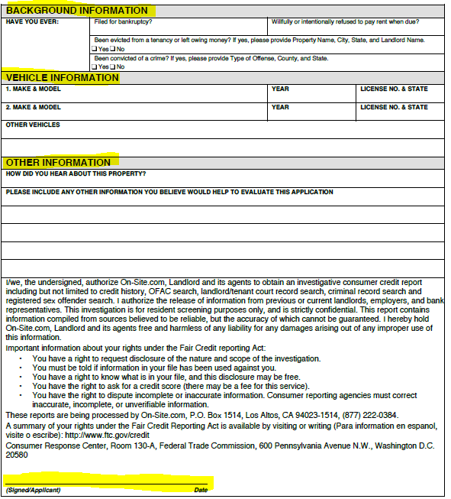
This is what a typical rental application looks like Make sure to fill out all necessary information and submit all required documentation
Notes:
This is what a typical rental application looks like. Make sure to fill out all necessary information and submit all required documentation.
Make sure to be honest on your application because most property management companies and landlord will run a background and credit check.
It is especially important to have each adult and child who will be living in the home listed under the other occupants section.
Some properties have an occupant limit and if you have more occupants than are on the application and lease agreement you can be served an eviction notice for breaching your lease agreement.
Please watch the video on Avoiding Evictions for more information on ways to avoid evictions.

Slide 4
Paying Application/ Credit Check Fee
Most property management companies & landlord will require an application/credit check fee to be paid at the time the rental application is submitted.
FSP can pay for one application/credit check fee.
Since you only receive one FSP application/ credit check fee,
please watch the House Search video for tips on making sure you meet all application requirements before using your one FSP application/credit check fee.
Notes:
Most property management companies & landlord will require an application fee which can also be called a credit check fee to be paid at the time the application is submitted.
FSP can pay for one application/credit check fee. Please see the House Search video for tips on making sure you meet all application requirements before applying and using your one FSP application/ credit check fee.
FSP can advance you funds for the application/ credit check fee and you will be required to submit a receipt.
However, if you pay for your application/ credit check fee out of pocket, FSP can reimburse the funds as long as you submit a receipt.

Slide 5
Background & Credit Check
Once you submit your rental application and pay your application/credit check fee, the property management company or landlord will run a background & credit check
The background check will look at your criminal history to determine if you have any criminal violations that will disqualify you from renting.
The credit check will look at your financial history to determine how financially responsible you are as a potential tenant.
Notes:
Once you submit your rental application and pay your application/credit check fee, the property management company or landlord will run a background & credit check
The background check will look at your criminal history to determine if you have any criminal violations that will disqualify you from renting.
The credit check will look at your financial history to determine how financially responsible you are as a potential tenant.
Again, make sure you have researched the application requirements before applying because having certain criminal violations or a low credit score, bills in collections or evictions can disqualify you from being approved.

Slide 6
Proof of Income
Property management companies & landlords want to make sure you have the income available to pay your rental amount each month.
It is important to have proof of income to submit with your rental applications.
Proof of income can be:
Passport to Services
Recent Paystubs
Bank Statements
Make sure you have these available when you are applying so you do not delay the rental application process.
Notes:
Property management companies & landlords will want to make sure you have the income available to pay your rental amount each month.
It is important to have proof of income to submit with your rental applications.
There are different types of proof of income such as:
Passport to services, recent paystubs and bank statements.
Make sure you have proof of income available when you are applying so you do not delay the rental application process.
If you need a passport to services you can ask your FSP social worker to mail one to you.

Slide 7
The content given is for informational purposes and is not legal advice.
You should always contact a lawyer for legal questions.
Greater Bakersfield Legal Assistance can be reached at 661.325.5943

